Slide 1
CHINOOK SALES ANALYSIS
Vaibhav Mishra

Slide 2
PROBLEM STATEMENT
Analyze music record sales data to gain insights and make recommendations for the company's strategy in the physical music market.

Slide 3
Data Description
customer:
customer_id: Unique identifier assigned to each customer.
first_name: The given name or first name of a customer.
last_name: The surname or family name of a customer.
company: The name of the company associated with a customer.
address: The street address of a customer's location.
city: The city where a customer is located.
state: The state or province where a customer is located.
country: The country where a customer is located.
postal_code: The postal or zip code of a customer's address.
phone: The phone number of a customer.
fax: The fax number associated with a customer.
email: The email address of a customer.
support_rep_id: The employee ID of the support representative assigned to a customer.
employee:
employee_id : Unique identifier assigned to each employee.
last_name : Last Name of the Employee.
first_name : First Name of the Employee.
title : Designation of the Employee.
reports_to: employee id of the person the Employee reports to.
birthdate : Date of Birth of the Employee.
hire_date : Date the employee was hired on.
city : The city where the employee lives.
state : The state where the employee lives.
Country: Nationality of the employee.
postal_code: Employee postal code.
Phone: The phone number of employee.
Fax: Fax number of employee.
Email: Email of employee.

Slide 4
Data description
invoice:
invoice_id: Unique identifier assigned to each invoice.
customer_id: The customer ID associated with the invoice.
invoice_date: The date when the invoice was generated or issued.
billing_address: The street address used for billing purposes.
billing_city: The city used for billing purposes.
billing_state: The state or province used for billing purposes.
billing_country: The country used for billing purposes.
billing_postal_code: The postal or zip code used for billing purposes.
total: The total amount due on the invoice.
invoice_line:
invoice_line_id: Unique identifier assigned to each line item on an invoice.
invoice_id: The invoice ID to which the line item belongs.
track_id: The ID of the track or product included in the line item.
unit_price: The price per unit for the line item.
quantity: The quantity of units for the line item.
playlist:
playlist_id: Unique identifier assigned to each playlist.
name: The name or title of the playlist.
playlist_track:
playlist_id: The ID of the playlist to which the track belongs.
track_id: The ID of the track included in the playlist.
track:
track_id: Unique identifier assigned to each track or song.
name: The title or name of the track.
album_id: The ID of the album to which the track belongs.
media_type_id: The ID of the media type associated with the track.
genre_id: The ID of the genre associated with the track.
composer: The name of the composer or artist who composed the track.
milliseconds: The duration of the track in milliseconds.
bytes: The file size of the track in bytes.
unit_price: The price per unit for the track.

Slide 5
Data description
album:
album_id: Unique identifier assigned to each album.
title: The title or name of the album.
artist_id: The ID of the artist associated with the album.
artist:
artist_id: Unique identifier assigned to each artist.
name: The name of the artist.
media_type:
media_type_id: Unique identifier assigned to each media type.
name: The name or description of the media type (e.g., MPEG audio file, AAC audio file).
genre:
genre_id: Unique identifier assigned to each genre.
name: The name or description of the genre (e.g., rock, pop, classical).

Slide 6
OBJECTIVE
KEY METRICS
AND
VISUALISATIONS

Slide 7
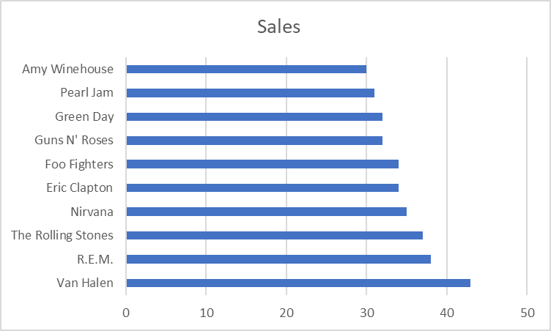
Top Artists by Sales in USA
Insights:
Van Halen has the highest number of Sales in USA demographic.
Artists except the top 3 lie in relatively similar range of sales
Recommendations:
A focused marketing campaign for Van Halen, The Rolling Stones and R.E.M can drive up revenues due to their huge popularity among the customers.
Offers or discounts are recommended for the other 7 artists in order to bridge the gap.

Slide 8
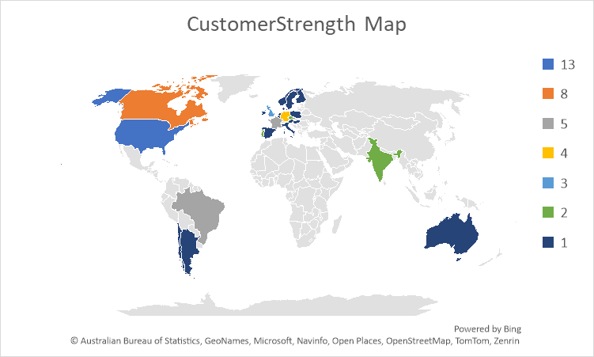
Global Customer Reach
Insights:
Large majority of the customers live in the Western Hemisphere.
There are no customers from Africa or the Middle East region.
Recommendations:
The track portfolio must be expanded to include regional music in order to attract customers from newer locations.
A focused marketing campaign in the Middle East should be launched to capitalize on the region's affluent population.

Slide 9
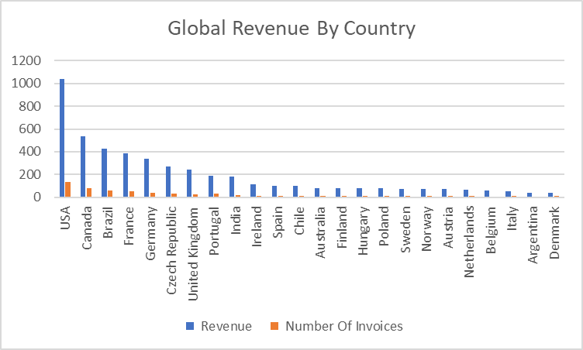
Global Revenue Distribution
Insights:
USA is the top country in terms of revenue.
The revenue from North America makes up a large share of the total revenue.
Recommendations:
European Revenue has the potential to be increased with offers and promotional campaigns focused on customers in that demographic.
The music catalogue must be expanded in order to include more genres and artists.

Slide 10
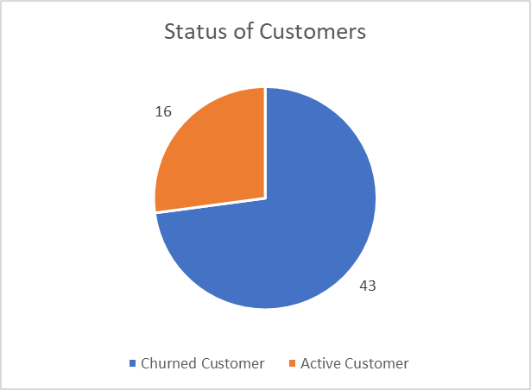
Customer Activity
Insights:
The chart shows 16 customers have not placed any orders within the last six months.
The company has the retention rate of 73%
Recommendations:
Further Analysis into the demographics of churned customers is to be conducted
Promotional emails and offers must be sent out to customers who haven’t made purchases in the last 6 months.

Slide 11
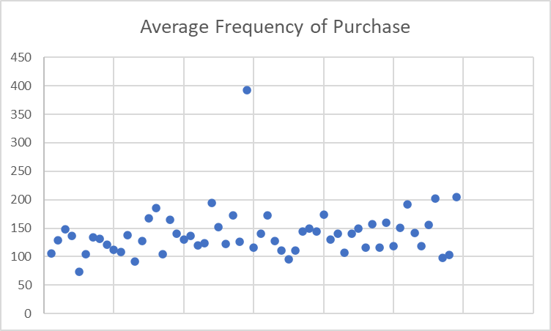
Purchase Frequency of Customers
Insights:
Most of the customers take 4-5 months between their purchases.
Recommendations:
Increased communication with the customers for feedback data
More discounts and offer emails along with new release suggestions.

Slide 12
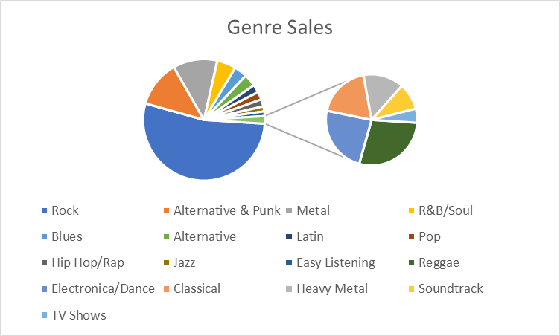
Genre Sales Analysis
Insights:
Rock has more than 50% of sales of the whole organisation.
Alternative & Punk and Metal are next with a similar but smaller stake in the sales.
Recommendations:
In order to attract newer customers more content in the different genres should be acquired.
Genres that are low in sales should be put on discounts and promoted.

Slide 13
SUBJECTIVE
INSIGHTS
AND
RECOMMENDATIONS

Slide 14
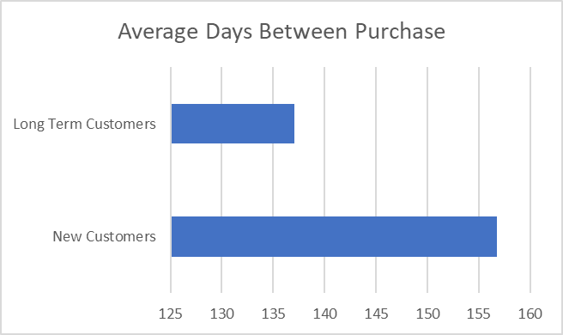
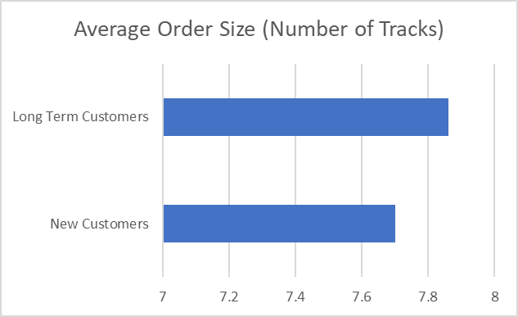
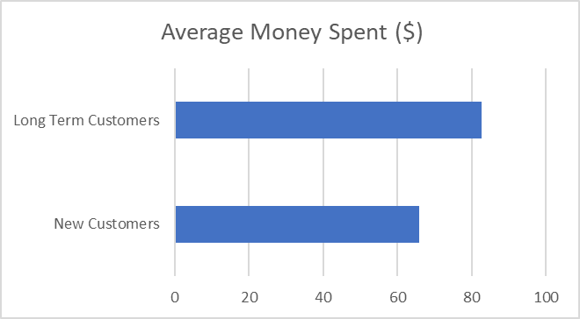
New vs Old Customer Characteristics
Insights:
Long Term Customers have significantly less days between their purchases
Long Term Customers lead in average money spent as well as order size.
Recommendations:
New Customers must be alerted on new offers and prioritised for discounts.
Feedback should be prioritised for new customers in order to learn and recommend tracks.

Slide 15
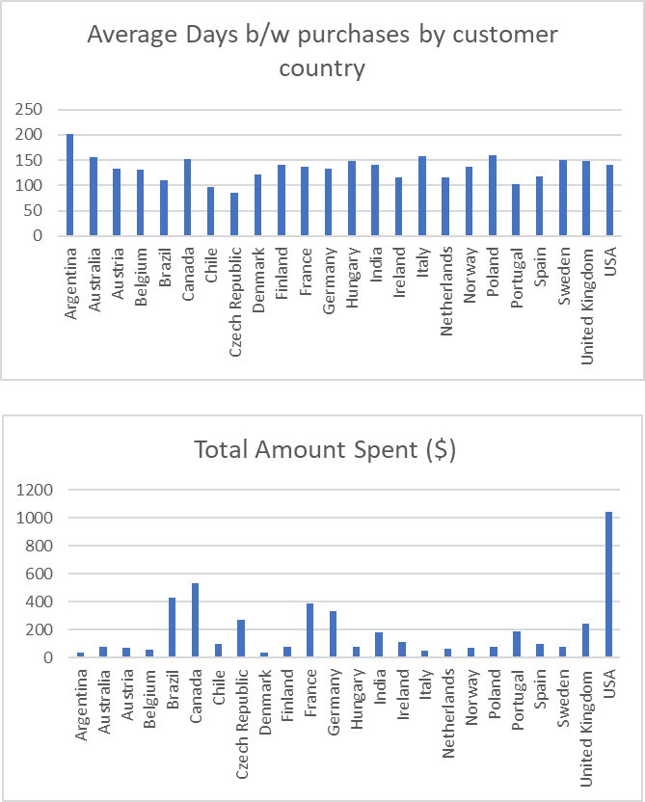
Global Customer Behaviour
Insights:
Argentinian customers have the highest number of days between their purchases while Czech have the lowest
USA customers lead the market in total amount spent indicating a strong customer base in the US.
Recommendations:
The musical catalogue should be expanded to attract Asian Customers and taking advantage of the huge revenue potential.
Frequent Promotional emails should be sent in order to increase customer engagement.

Slide 16
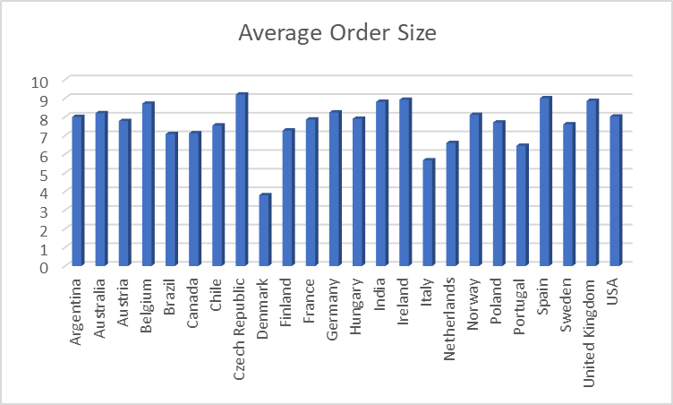
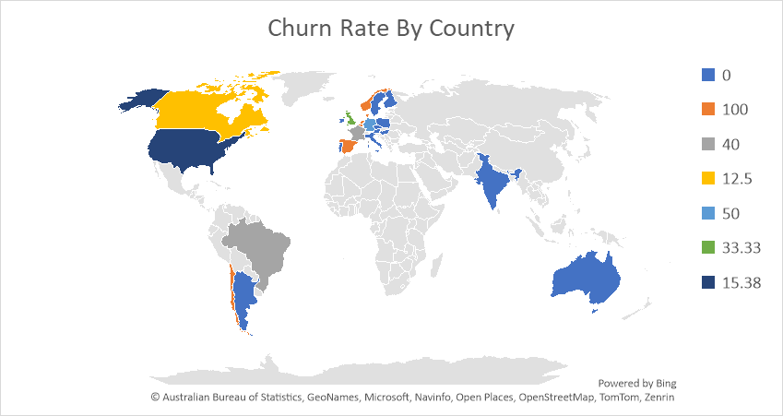
Average Order Size & Churn Rate by Country
Insights:
Average order size is least in Denmark while the higher end of average order size is shared by a lot of countries
Churn rate is maximum in South America and Northern Europe
Recommendations:
More feedback should be sought from European customers, and their concerns should be addressed effectively.
There should be more focus on acquiring regional music that appeals to local preferences.

Slide 17
Recommendations
Expand promotion efforts in Africa, Europe, and the Middle East to tap into emerging markets and capitalize on the growing demand for music in these regions.
Increase customer acquisition efforts through targeted marketing and advertising campaigns to grow the customer base and boost revenue.
Broaden the music catalog to include region-specific preferences, fostering a more diverse and global user base.
Re-engage inactive customers by offering discounts and promotions to improve customer retention and drive higher engagement.
Diversify the promotion of music genres beyond current successes, catering to a wider audience and increasing potential revenue streams.

Slide 18
Conclusion
Customer retention is a major issue in Chinook Music Label sales.
An expanded catalogue is very essential to ensure customer acquisition and engagement.
Promotional Campaigns will play a vital role in expanding the music business.
The music label should expand globally since most of the operations in the current period are centered in the United States.

Slide 19
Acknowledgement & References
Chinook Customer & Sales Database
Storytelling in Presentations, Tom Becker
MySQL Documentation

